Slide 1
Current Solution Performance Risk analyst team as a key success factor

Slide 2
Agenda
KPIs – Best customer examples
Industry benchmark examples
SAE profiling – Updated results and case studies
Using KPIs to sell against competition – We are PROVEN
Risk analyst team as key differentiator

Slide 3
Current Solutions Suite Coverage
ACI ReD Shield® Risk Services Global Team
Issuer Bank
Acquirer Processor
Merchant
ACI® Proactive Risk Manager™
ACI ReD Shield
Merchant Fraud (CNP)
Global Consortium Data
Rules + Machine + Learning
Multi-Tenant/Platform
BI – ACI ReDi ™ Business Intelligence
Global Risk Analysis
CNP (eCommerce/ Mobile/App)
Issuer/Payments Fraud
Enterprise Cross-Channel Monitoring
Profiling + Rules + Machine Learning
On-Prem or SaaS
Global Fraud Consulting Team
Card-Present/ DDA
EMV

Slide 4
Proactive Fraud Management Platform
Delivered in the cloud
ACI ReD Shield Risk Services Global Team
Incorporating real time rules…
Multi-dimensional rules engine
Silent rules and rules tailored by vertical
Machine learning/neural fraud scoring models
Device fingerprinting/IP geolocation
Data profiling and behavioral analytics
Global consortium fraud database
Offline tools, dashboards and alerts…
Business intelligence performance dashboards
Near real-time reporting
Retrospective alerts
The support of a dedicated risk analytics team
…delivering payments acceptance optimization
RULES
DATA
Historic and chargeback data
Fraud
detection rules
EDUCATION
ANALYSIS
REPORTING
Real-time location analysis
PROFESSIONAL
EXPERTISE
(Risk Analysts)
Database and negative files
Neutral networks
Pattern detection engines

Slide 5
Risk Analysts
Certified eCommerce fraud prevention professionals:
Subject matter experts in payments and in the fraud space through professional and managerial references
Expertise through the publishing of their work in a public domain or by speaking at a recognized event on CNP fraud, electronic payments or online security
Completion of 16 courses that include core fraud operational procedures, core fraud strategy and solution methodologies
Average of seven years at ACI
Advanced education in machine learning/predictive modeling, analytics and statistics
Assigned a base of accounts that best fit their existing merchant portfolio

Slide 6

Global Hosted Risk Services – Reach and Scale
Certified eCommerce Fraud Professionals
17 Supported Languages
Hosted Application, Global Service
22 Analyst Globally
Supporting many Accounts
South West - London
New Jersey
Mumbai
Singapore
Sao Paulo
Analyst locations
Sydney
Follow-the-Sun Support

Slide 7
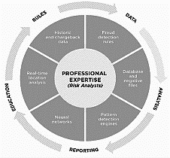
ACI ReD Shield Current – Global Structure of Risk Services – Hosted
Teams Languages:
Arabic
Cantonese
Chinese Mandarin
English
French
Hindi
Italian
Konkani
Korean
German
Risk Director - Global
Gujarati
Greek
Portuguese
Russian
Spanish
Urdu - Hindustani
Welsh
Risk Director - Region
Senior Principal
Principal- ReD Shield/Proactive Risk Manager
Risk team managed service
Analysts globally
Multiple languages
Manage KPIs per customer
Global fraud experts/analysts
…Or manage in house (rule manager/ACI ReDi)
Senior Risk or Systems Analyst
Risk or Systems Analyst
Associate Risk Analyst

Slide 8
Responsibilities
Responsibility of VP, director, risk manager(s), and principals of global risk services
Drive a consistent fundamental approach to deliver high-quality risk services globally, ensuring that client strategies and key performance indicators (KPIs) exceed market performance on ACI ReD Shield
Upsell additional services to existing accounts
Regularly meet onsite with clients to understand their fraud and order management business challenges proposing ACI solutions
Regularly speak at conferences and provide commentary and statistical conclusions for press releases, seen as thought leader
Manage and scale the risk services team through working with product on feature advancements
Support ACI ReD Shield pre-sales, specific to KPIs and proof of concepts

Slide 9
Current: Global Structure of Risk Services – Hosted
Director of Americas –
Shyam Shah
VP Global Erika Dietrich – (U.S. Based)
Desiree Leverich
Steven Ng
Manager of Risk EMEA –
Julia Roberts
Jennifer Fox
Nick Sarris
Whitney Henry
Manager of APAC –
Kerrie Sherwood
Ashley Wilson
Craig Jones
Brian Siao
Cyrus Mwangi
Renee Tu
Willa Jiang
Sharell Barshishat
Pat Hengeveld
Clement Kan – Singapore
Raheel Ahmad
Samar Shah
Nandkishor Rajak –
Mumbai
Daniel Tressi –
São Paulo
Average employee tenure is seven years
13 certified eCommerce fraud professionals
Degrees in computer/data sciences, computer information systems, mathematics and actuarial science

Slide 10
Global Hosted Risk Services – KPI Dashboard
2019 October key points, addressed 1,903 client requests
60 Custom Client Risk Assessments presented

Slide 11
Client Queries – Actions for Improvement
We review the requests of Customers to determine areas for product advancement.
Example : Additional Sector Models, New Rule Manager

Slide 12
Example Client Risk Assessments and POCs – Internal Use Only
AXS.com - AXS is a digital marketing platform for purchasing tickets for sports and entertainment events in the U.S., and overseas.
B&H Photo Video - An American photo and video equipment retailer founded in 1973, based in Manhattan, New York City. B&H conducts business through online eCommerce consumer sales, business-to-business sales, and it has one retail location.
IKEA is a European multinational group that designs and sells ready-to-assemble furniture, kitchen appliances and home accessories, among other useful goods and occasionally home services.
It Works is a direct sales company that specializes in products related to body shape, skincare and nutrition.
Maven is a car sharing service that was announced by General Motors in January 2016. The program also includes former Google and Sidecar employees.
Singapore Airlines Limited is the flag carrier airline of Singapore with its hub at Singapore Changi Airport.
POCs
Amtrak - The National Railroad Passenger Corporation, doing business as Amtrak, is a passenger railroad service that provides medium- and long-distance intercity service in the contiguous United States and to nine Canadian cities.
Adidas - Adidas AG is a multinational corporation, founded and headquartered in Herzogenaurach, Germany, that designs and manufactures shoes, clothing and accessories. It is the largest sportswear manufacturer in Europe, and the second largest in the world, after Nike.

Slide 13

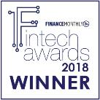





Industry Recognized
Award-winning payments and fraud management capabilities
Best-in-class Fraud Tool
Best ID, Security and Anti-Fraud Solution of the Year
Fraud Innovation Firm of the Year – 2018
Ranked #2 Of the Top 25 cross-border payment and providers
Best Online Payments Solution of the Year (Merchant)
International Award
Notes:
Our eCommerce payments and fraud solution is being recognized widely by the industry for both payments and fraud management.

Slide 14
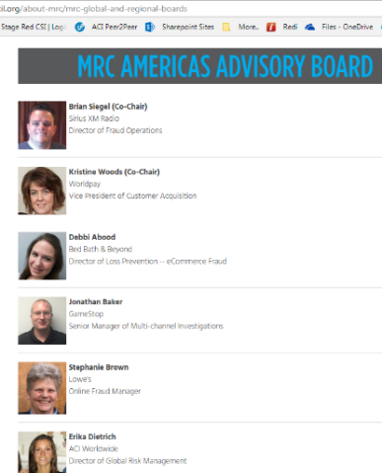
Merchant Risk Council – Americans Board Member
https://www.merchantriskcouncil.org/about-mrc/mrc-global-and-regional-boards
About Merchant Risk Council
As an independent, not-for-profit business association, the Merchant Risk Council's mission is to facilitate collaboration between eCommerce payments and risk professionals. Year-round, the MRC provides valuable resources to its members that include proprietary educational content, webinars, best practices, industry trends, benchmarking reports and whitepapers. In addition, the MRC hosts four annual conferences in the U.S. and Europe, as well as several regional networking events which provide an opportunity for industry professionals to build stronger connections with industry stakeholders.
ACI on the Board!

Slide 15
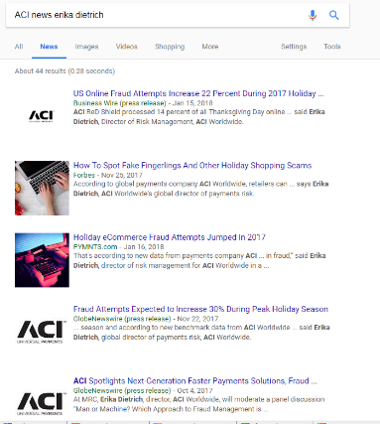
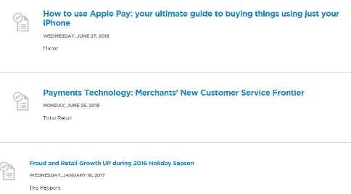
Industry Recognized
Supporting events and press release
Risk services presents the statistical fraud trends for press release and speaking engagements. Examples:
https://www.aciworldwide.com/news-and-events/events
Risk Services delivered the content

Slide 16
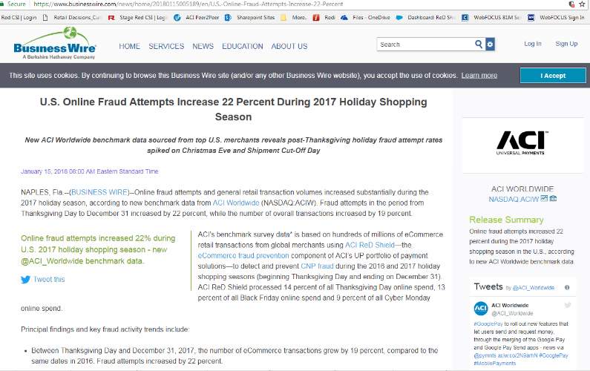
Press Release Example
https://www.businesswire.com/news/home/20180115005189/en/U.S.-Online-Fraud-Attempts-Increase-22-Percent

Slide 17
ACI key performance indicators

Slide 18
Production Results from the New Technology – Gap
Supporting business growth in real time on ACI ReD Shield
Our KPIs for Merchant Business Empowerment and Risk Management
Full transparency of all KPIs
Of all 35% are canceled
Market avg.
ACI avg.
Challenges – Can be decisioned automatically using automated data authentication capabilities and features.

Slide 19
Production Results from the New Technology – Nintendo
Supporting business growth in real time on ACI ReD Shield
Our KPIs for Merchant Business Empowerment and Risk Management
Full transparency of all KPIs
Market avg.
ACI avg.
Challenges – Can be decisioned automatically using automated data authentication capabilities.

Slide 20
Production Results from the New Technology – Singapore Air
Supporting business growth in real time on ACI ReD Shield
Our KPIs for Merchant Business Empowerment and Risk Management
Full transparency of all KPIs
Of all 34% are canceled
Market avg.
ACI avg.
Challenges – Can be decisioned automatically using automated data authentication capabilities and features.

Slide 21
Detecting Different Types of Fraud; Channels – Transactional or Event
Common Types of Fraud Detected:
Account takeover
Sleeper accounts
Application fraud
Velocity attacks or identity testing
Credential Stuffing
Friendly fraud – Cardholder denies making the purchase, receiving the goods or family member makes purchase without cardholder approval.
Affiliate fraud
Re-shipper – Mule shipping
Common Channels or Events:
Online
Buy online pick up in-store
Buy in-store ship home
Call center
Account setup
Gift card
Gift card balance inquiry
Application setup
Account top-up
Invoice
Kiosk
Rewards redemption
Market place
Digital download
Mobile
Botnet attacks – High volume of compromised machines making purchases often using stolen payments information
Triangulation – Auction sites posting products the seller doesn’t have
Return fraud
Internal fraud
Package re-directing
Bust-out
Man-in-the-middle
Loyalty, rewards or coupon abuse

Slide 22
The Power of the Multi-Layered Approach – All Aspects Monitored and Measured for KPI Performance
5% Business Rules
4% Email
Consortium data utilizes profiling capabilities applied across global transactional data and known fraud intelligence.
17% Velocity
5% Address Verification Service
6% IP Geolocation
Consortium data should be one feature of several features used within a successful fraud strategy.
10% Device ID
18% Model
Combination of approaches/tools provides best results to minimize false positives and increase conversion.
11% Consortium Data
14% Pattern
10% Purchase Behavior

Slide 23
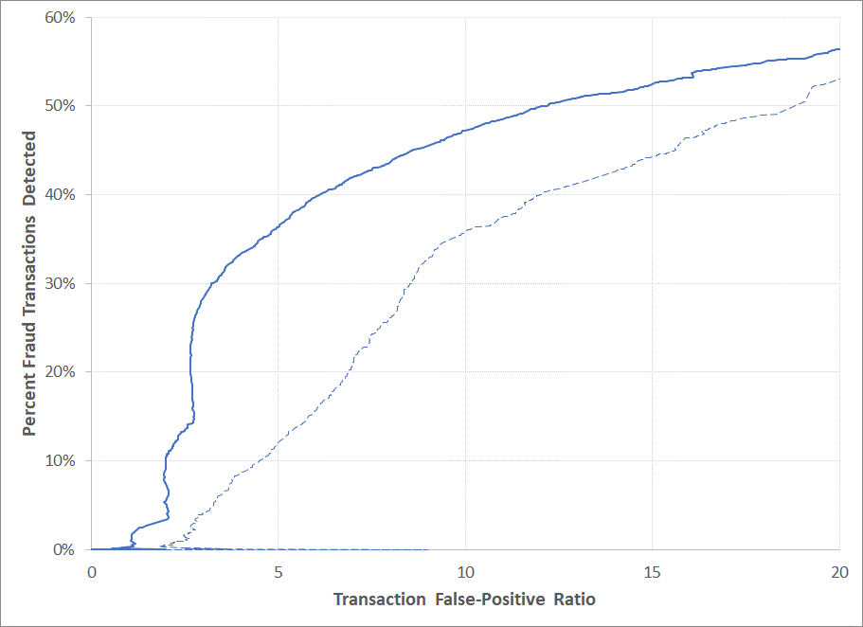
Models in Production today
New Model
Old Model
ReD Shield Models:
Gaming Europe
Gaming North America and Asia
Retail Model
Telco Model
Travel Model
American Eagle
Eastbay
Gap
Macys
Global Tel Link Telco Model
At a 5:1 False-Positive Ratio fraud detection percentage will increase from 12% to 36% while reducing false positives by 24%, estimated reduction of 300 orders daily based on the model score.

Slide 24
ACI ReD Shield differentiators: Consortium database

Slide 25
Consortium Database
ACI ReD Shield Facts:
2M+ decisioned transactions at a value of $230M daily
10K fraudulent data points collected daily
Processing 40+ data sources daily
$800K or 0.35% detected negative data alerts daily
850+ Merchants
250+ direct merchants and PSPs
600+ indirect merchants
Future – Hadoop
ACI PAY.ON Payments Gateway:
4M transactions daily
UP Bill Payment :
2M payments/business day
Platforms : D1, V4, Infinity, Transact, and Speedpay
ACI ReD Shield Merchant Data
ACI ReD Fraud Xchange – Issuer Alerts
Fraud Chargeback Data
*Future
Bill Pay
ACI PAY.ON
PRM – FIs
Merchant Confirmed Fraud
Autopilot – Bot Attack Blocking
Positive Profiling
Negative Data

Slide 26
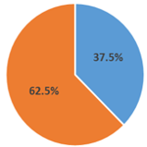
Consortium Database Model
Retail merchant proof of concept
Small data sample – 4,794 transactions (IP, card number, phone number and customer email)
Most matches came from card number with 143 orders and IP address with 94 orders.
5.75% negative hit rate
62.5% of customers have shopped at another ACI customer.
Match Type | # Items Flagged | Value | ACI Time on File – Shopped at ACI Client in Past
IP match | 94 | $4,968
Card match | 143 | $12,103
Phone match | 13 | $752
Email match | 26 | $1,772
Total | 276 | $19,595

Slide 27

Stream Analytics Engine in Action: Customer Results
Increased revenue of $55K per month
By applying positive profiling to an existing rule, this client would improve its decline rate by 8%, resulting in increased revenue of $55K per month.
£348k more per month in transactions
Using the Global Time on File Profile indicator, this client would have accepted around £348k more per month in transactions.
£2,190,326 in additional transaction value
Applying positive profiling, this clients top six hitting rules resulted in 4,427 fewer challenged transactions, of which 3,264 would have been declined. Accepting these declined transactions would have yielded £2,190,326 in additional transaction value.

Slide 28
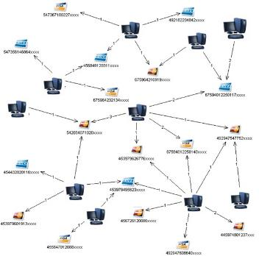
Screening Database and Autopilot Processor​
Real-Time
Fraud Prevention Layer
Post-Real-Time Prevention & Detection Layer
ACI ReD Shield Screening Database Blocks (SDS)
Autopilot monitors real-time responses and automatically blocks associated order elements when fraud is detected (near-real-time)‏ to screening database (SDS)
Example: Deny more than 30 transactions per email address in one hour and email, device and payments ID have no prior history and machine learning score is greater than 600
Create SDS blocks based on a transaction(s) that deny as a result of the above rule, blocking the associated email, card number and device associated to the transaction.
ACI ReD Shield
Autopilot
Batch
Analysis
Post-Real-Time Batch Analysis
Analysis of previously-processed real-time transactions in multi-hour batches in order to identify and alert on emerging fraud trends

Slide 29
Session Questions​
How many languages are supported by risk team?
As a team please call out 10 types of fraud that can be detected by ReD Shield?
How many client requests did Risk Services address in October 2019?
How many Custom Client Risk Assessments presented?
What percentage of detection does Consortium data provide out of 100%?
What competitors do NOT have a Consortium database?
Can you help us with Prospects POC’s in 2020?
Notes:
How many languages are supported by risk team? 17
As a team please call out 10 types of fraud that can be detected by ReD Shield?
How many client requests did Risk Services address in October 2019? addressed 1,903
How many Custom Client Risk Assessments presented in Oct? 60
What percentage of detection does Consortium data provide out of 100%? 11%
What competitors do NOT have a Consortium database? 3
Can you help us with Prospects POC’s in 2020?

